Slide 1


Job Market Analysis Projects: Uncovering Trends and Insights
This presentation explores key job market analysis projects to understand evolving labor trends and inform strategic decision-making.
by vicky saini

Slide 2
Analyzing Salary Patterns by Job Title
Data Collection
Pattern Identification
Gather salary data from reputable sources like Glassdoor, Indeed, and Salary.com. Ensure a diverse set of data points for accurate analysis.
Analyze trends in salary ranges for specific job titles, factoring in factors like experience, location, and industry. Identify potential anomalies and outliers.

Slide 3

Identifying Emerging Job Categories
Industry Research
Skill Analysis
Study industry reports and publications on emerging technologies and trends, looking for new roles driven by innovation and advancements.
Analyze the specific skills and qualifications needed for these emerging roles, identifying skills gaps and potential training needs.
Market Demand
Assess the demand for these emerging job categories through job postings, industry forums, and expert insights.

Slide 4




Predicting High-Demand Roles
Industry Growth
Focus on industries experiencing significant growth, indicating a higher demand for skilled professionals in those sectors.
In-Demand Skills
Identify skills that are consistently in high demand across various industries, suggesting these skills will be crucial for future roles.
Emerging Technologies
Analyze emerging technologies and trends that will drive new job roles and skill requirements in the future.

Slide 5
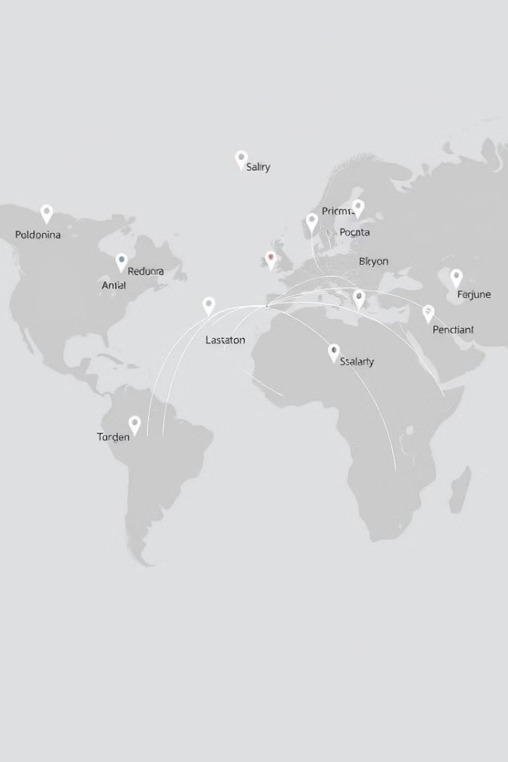
Comparing Geographic Salary Differences
1
Collect salary data from different geographic regions, ensuring consistent data sources for accurate comparisons.
2
Analyze salary differences across regions for similar job titles, considering cost of living, local market conditions, and industry variations.
3
Identify potential opportunities for job seekers and employers, highlighting regions with higher salary potential and lower competition.

Slide 6
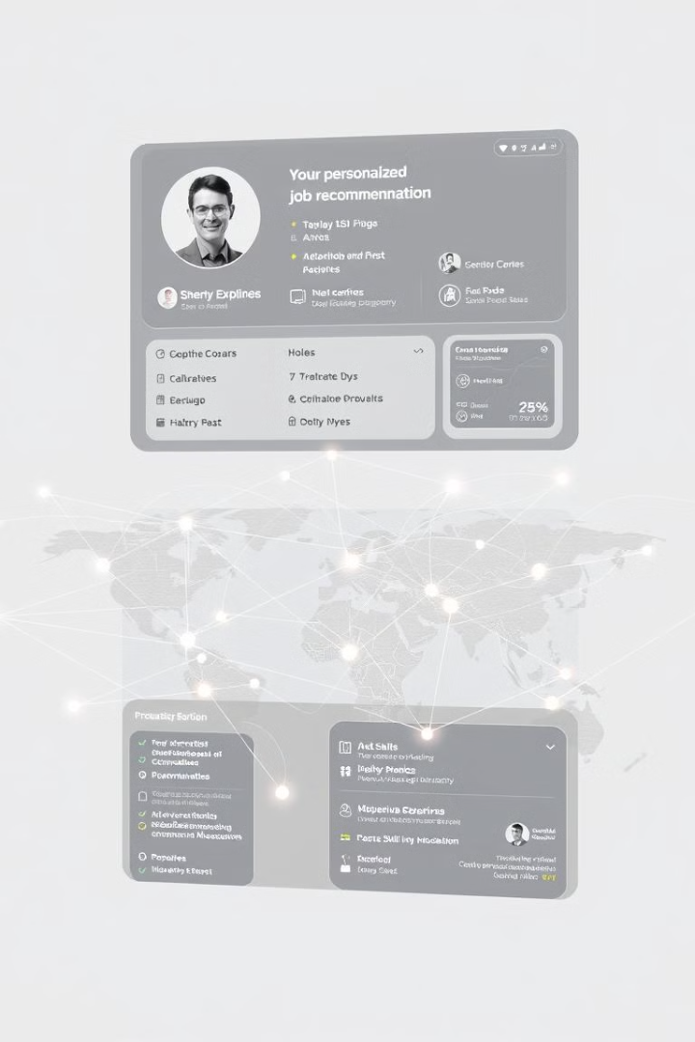
Creating a Personalized Job Recommendation System
1
Skill Assessment
Gather data on an individual's skills, experience, and career aspirations to create a comprehensive profile.
2
Job Matching
Match the individual's profile with relevant job opportunities based on skills, experience, and location preferences.
3
Personalized Recommendations
Provide personalized job recommendations tailored to the individual's unique qualifications and career goals.

Slide 7

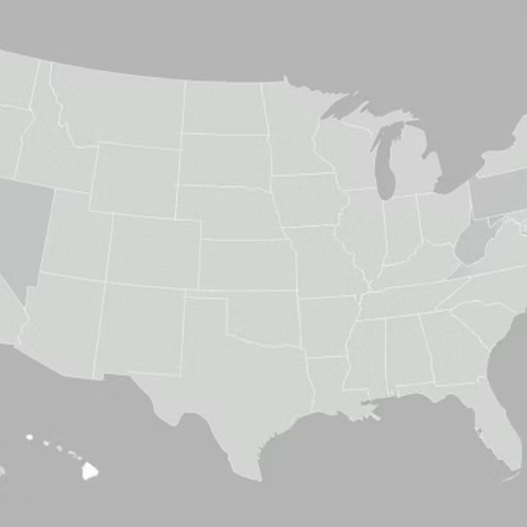
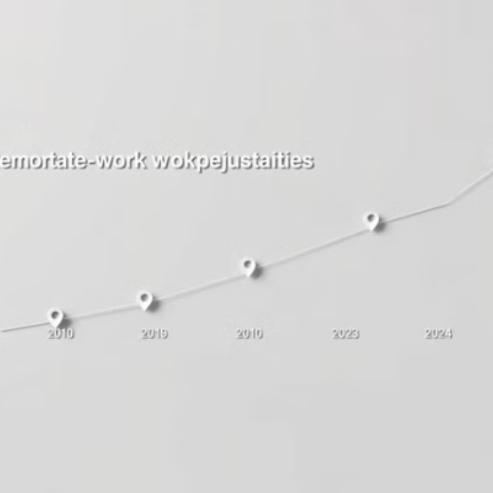
Visualizing Job Market Trends

Slide 8




Studying the Shift to Remote Work
Data Sources
Gather data on remote work trends from job postings, surveys, and industry reports, tracking the increase in remote work opportunities.
Impact Analysis
Analyze the impact of remote work on industries, work culture, and employee productivity, identifying both challenges and benefits.
Future Projections
Forecast future trends in remote work, considering factors like technology advancements, employee preferences, and economic conditions.

Slide 9



Forecasting Future Job Market Trends
Technology Trends
1
Analyze emerging technologies and advancements that will reshape industries and create new job roles.
Economic Factors
2
Study economic indicators and forecasts to understand their potential impact on employment and labor markets.
Demographic Shifts
3
Consider demographic trends and shifts in the workforce, such as aging populations and changing skill sets.

Slide 10

Key Takeaways and Next Steps
These job market analysis projects provide valuable insights for navigating the evolving labor landscape. Continuously monitor data and adapt strategies to optimize opportunities and mitigate potential risks.

